Slide 1


Vidya Vikas Institute of Engineering and Technology, Mysuru
Project Titled
“Smart Sericulture: Automated Disease Diagnosis in Silkworms Using CNN”
Team Members
HARSHITHA N 4VM22CS013
KEERTHANA K T 4VM22CS014
ARUNA P 4VM23CS402
SINCHANA Y M 4VM23CS412
Under the Guidance
Deepu G
Assistant Prof
Dept of CSE, VVIET
Department of Computer Science and Engineering
Vidya Vikas Institute of Engineering and Technology
Mysuru – 28
2025-26

Slide 2

Contents
Introduction
Literature survey
Problem statement
Objectives
Hardware and Software requirements
Methodology
Flowchart
Results
References

Slide 3
Introduction
Silkworm disease detection using CNNs is an AI-based method that identifies diseases like Grasserie and Pebrine from images of infected silkworms. It replaces manual inspection with automated, accurate, and fast detection by learning visual features through deep learning. This approach helps farmers take timely action and improve silk production efficiency.

Slide 4
Literature survey
SL NO | Title of the paper | Author Name | Year of publishing | Outcome
1 | A Novel Approach For Silkworm Disease Detection And Classification By Using CNN And Image Processing Techniques | Shilpa B Kodli, Anita | 2025 | Its ensemble nature also makes it robust to noisy image data and provides feature‐importance insights.
2 | Silkworm yield prediction: Exploring Leaf types and Species | Suchitha H S Anish, Gagandeep J E , Manoj M , Manu G | 2025 | The results emphasized the importance of leaf quality and species-specific responses for optimizing silk production, offering.
3 | A comprehensive prediction system for silkworm acute toxicity assessment of environmental and in-silico pesticides | Yutong Liu, Houhu Zhang, Yue Yu , Hua Wu , Bing Wu, Jieshu Qian | 2024 | The model demonstrated high predictive accuracy and reliability, offering a low-cost, efficient tool for ecological risk evaluation and green pesticide design.

Slide 5
Literature survey
4 | Grasserie disease detection in silkworm using machine learnng methods | Manju G | 2024 | Machine learning techniques to detect Grasserie disease in silkworms, improving early diagnosis accuracy and aiding sericulture farmers in disease management.
5 | Grasserie Disease Identification in Bombyx Mori Silkworm using Ensemble Learning Approach Ensemble Learning Approach | Raghavendra CG, Dharini Raghavan | 2022 | The proposed model achieved a test accuracy of 81.81% and is suitable for real-time implementation on hardware like Raspberry Pi for practical use by farmers, enabling early disease detection and minimizing economic losses.
6 | Development of a Muga Disease Early Warning System – A Mobile-Based Service for Seri Farmers | Jonali Goswami, Nasreen Rasid, D K Gogoi | 2021 | A mobile-based Muga Disease Early Warning System was developed to predict flacherie disease in silkworm farms 5–10 days in advance, helping farmers take timely preventive measures and reduce crop loss.

Slide 6
Literature survey
7 | The evolutionary road from wild moth to domestic silkworm | Hui Xiang, Xiaojing Liu, Muwang Li | 2018 | Nitrogen metabolism and circadian rhythm were under strong selection, contributing to enhanced silk production and adaptation to farming conditions. These findings deepen understanding of insect domestication and offer resources for improving silkworm breeding.

Slide 7
Problem statement
Manual detection of diseases in silkworms and mulberry leaves is slow, inaccurate, and dependent on expert knowledge, making large-scale monitoring difficult. The lack of automated tools leads to delayed treatment and increased loss in sericulture. This project aims to develop a CNN-based system that automatically identifies diseases from images, providing fast and reliable detection to support efficient sericulture management.

Slide 8
Objectives
To develop an automated system using CNN for detecting diseases in both silkworms and mulberry leaves.
To identify infections at an early stage with high accuracy, helping prevent crop and cocoon loss.
To reduce manual effort and time required for disease diagnosis in sericulture.
To provide farmers with a user-friendly and scalable tool for timely preventive measures.

Slide 9
Hardware requirements
Intel Core i5
Minimum 8 GB RAM
At least 250 GB of storage
GPU (Graphics Processing Unit)
Camera or smartphone
64-bit operating system

Slide 10
Software requirement
Operating System
Python
VS Code
TensorFlow
Keras
Flask

Slide 11
Methodology
Data Collection
Data Preprocssing
Model Design
Model Training
Model Evalution
Deployment
Result Analysis & Improvement

Slide 12
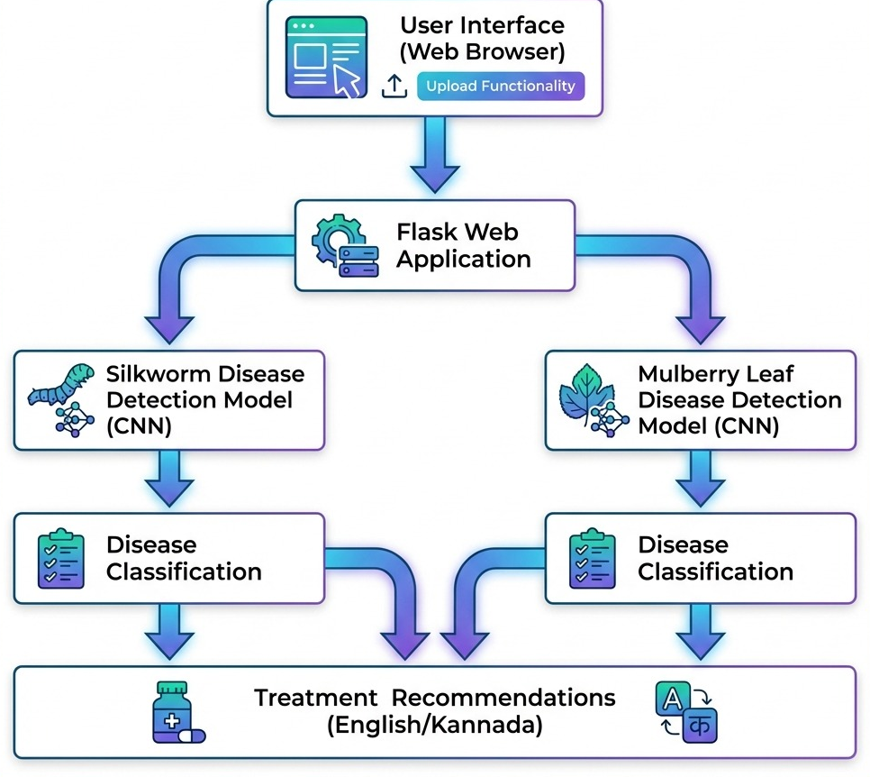
Flowchart

Slide 13
Work Carried out so Far
Conducted an extensive literature review to understand existing disease detection methods.
Compiled an initial dataset of silkworm images from reliable sources.
Developed an early-stage image classification model using convolutional neural networks (CNN).
Tested the model with a small dataset to evaluate preliminary accuracy and identify areas for improvement.

Slide 14
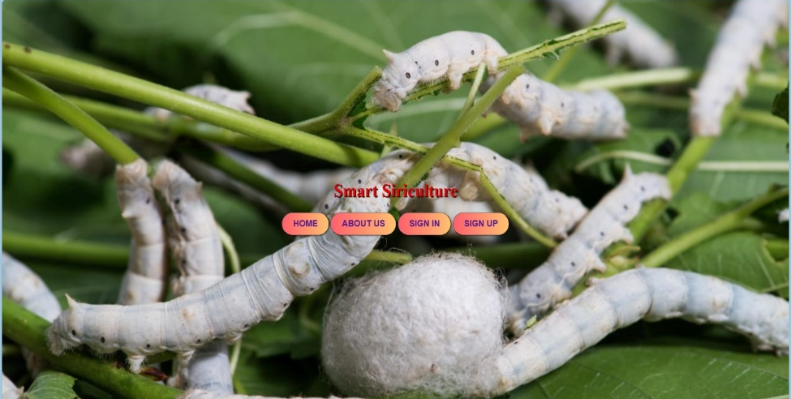
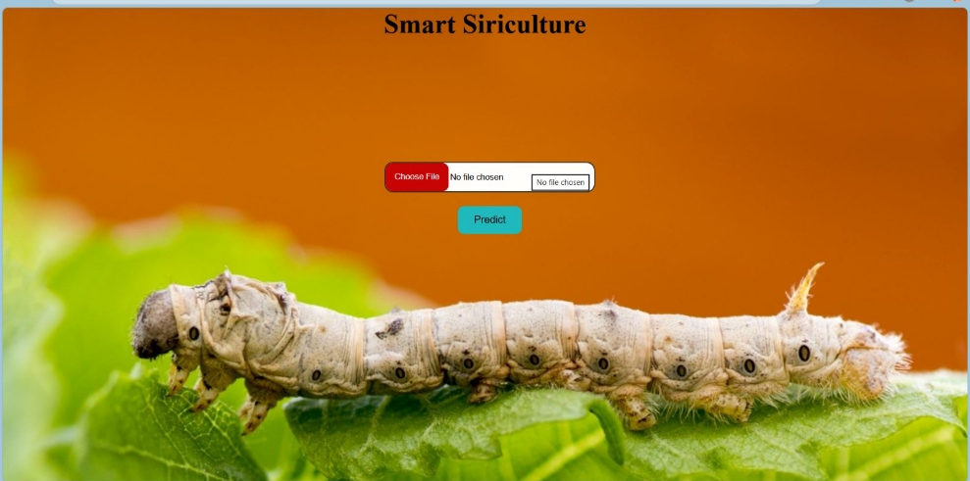
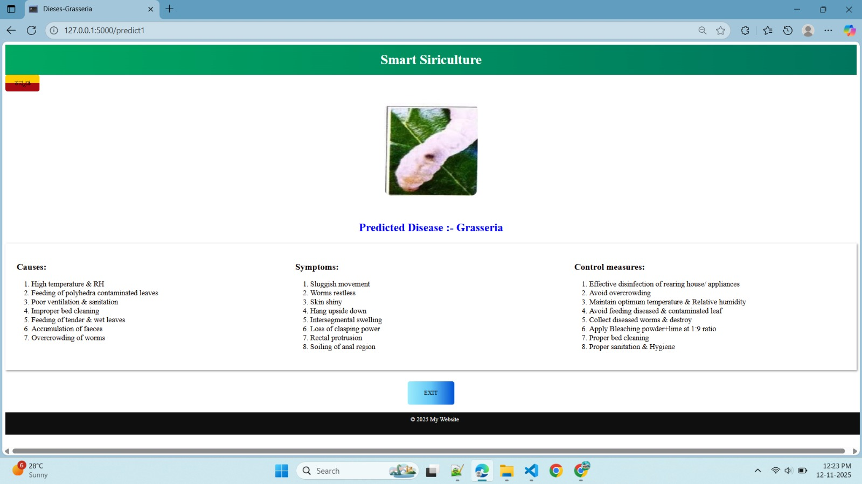
Results

Slide 15
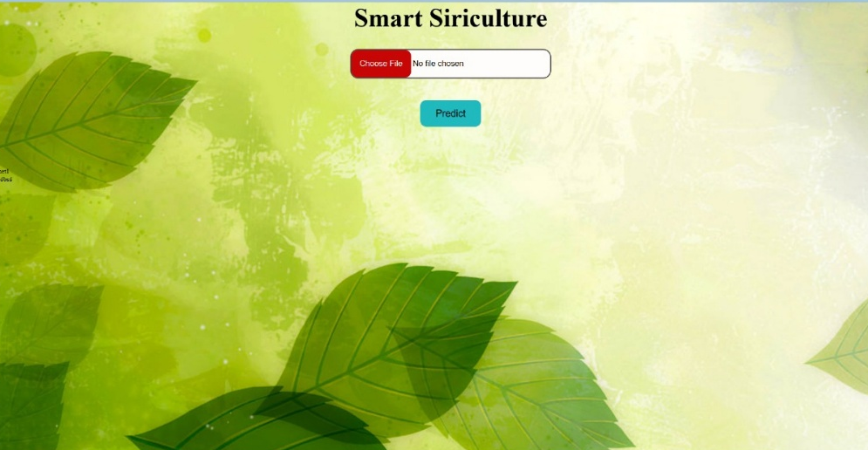
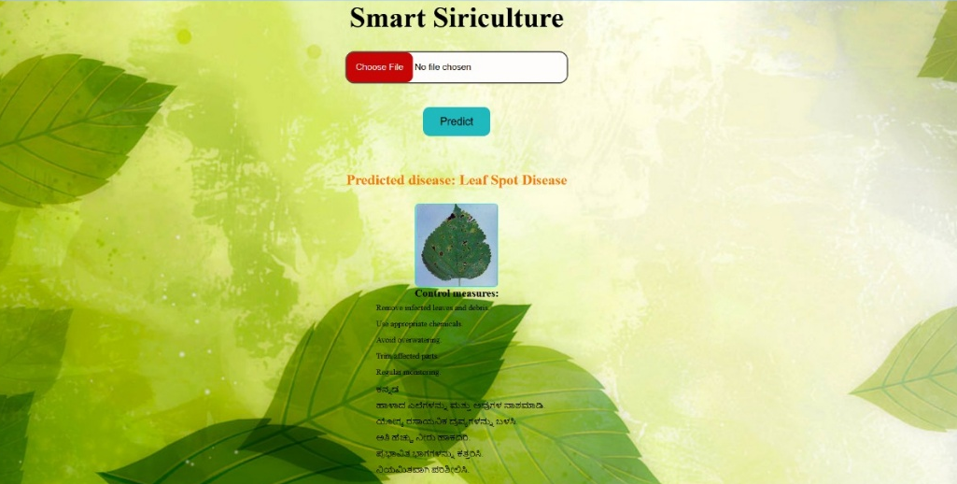
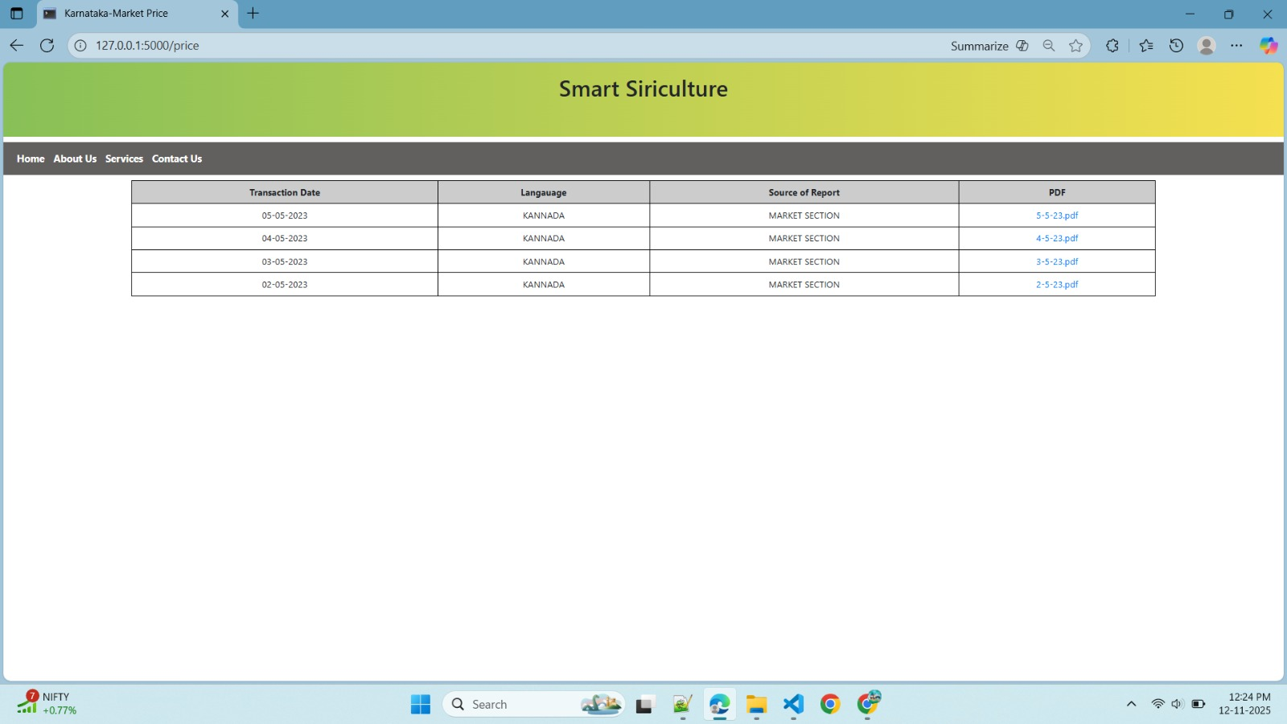
Results

Slide 16
References
[1] Shilpa B. Kodli and Anita, A Novel Approach for Silkworm Disease Detection and Classification by Using CNN and Image Processing Techniques, 2025.
[2] Suchitha H. S., Anish A. R., Gagandeep J. E., Manoj M., and Manu G., Silkworm Yield Prediction: Exploring Leaf Types and Species, 2025.
[3] Yutong Liu et al., A Comprehensive Prediction System for Silkworm Acute Toxicity Assessment of Environmental and In-Silico Pesticides, 2024.
[4] Manju G., Grasserie Disease Detection in Silkworm Using Machine Learning Methods, 2024.
[5] Raghavendra C. G. and Dharini Raghavan, Grasserie Disease Identi-fication in Bombyx Mori Silkworm Using Ensemble Learning Ap-proach, 2022.
[6] Jonali Goswami, Nasreen Rasid, and D. K. Gogoi, Development of a Muga Disease Early Warning System A Mobile-Based Service for Seri Farmers, 2021.
[7] Hui Xiang, Xiaojingnd Muwang Li, The Evolutionary Road frond Moth to Domestic Silkworm. 2018.

